Slide 1


API Automation
Day 2 - Features of Rest Assured

Slide 2
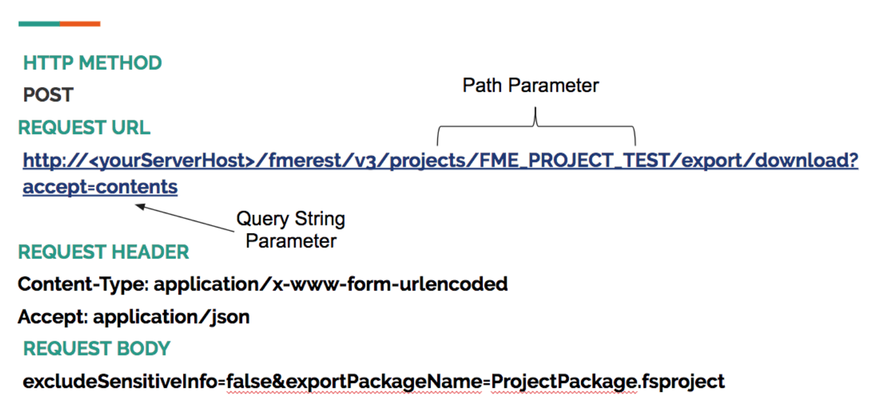
Request Data
1. Headers
2. Request body
3. Method Name
4. Content type
5. Parameters
6. Cookies

Slide 3
How To Specify Request Data
1. Headers
given().header("MyHeader", "Something").and(). ..
2. Request body
given().request().body("some body"). ..
3. Method Name
when().get("/x"). ..;
4. Content type
given().contentType("application/json"). ..
5. Parameters
given().param("myList", "value1", "value2"). ..
6. Cookies
given().cookie("username", "John").when().get("/cookie").then().body(equalTo("username"));

Slide 4
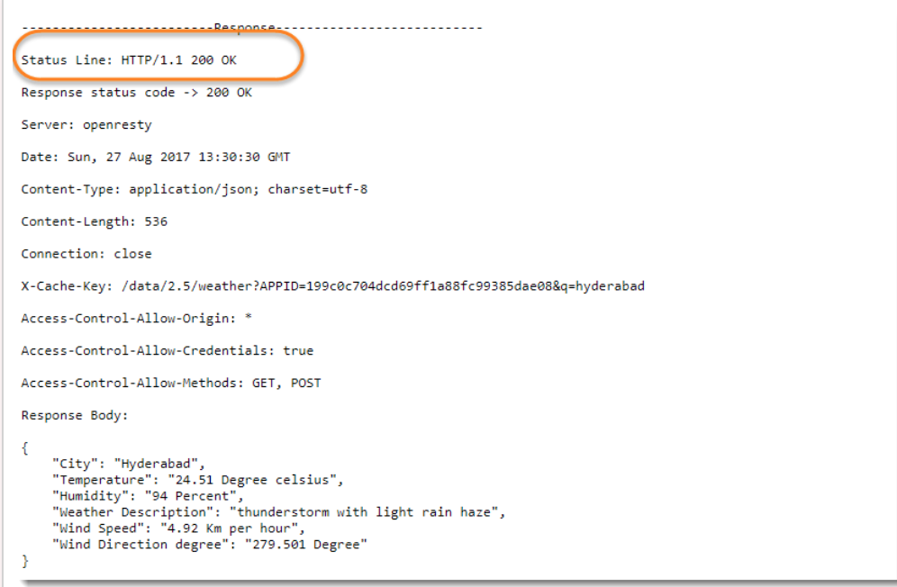
Response Data
1. HTTP Status Code
2. Status message
3. Headers and the Body of the response.
4. Content type
5. Schema Validation
6. Cookies and Their Values
Notes:
explain with image or content

Slide 5
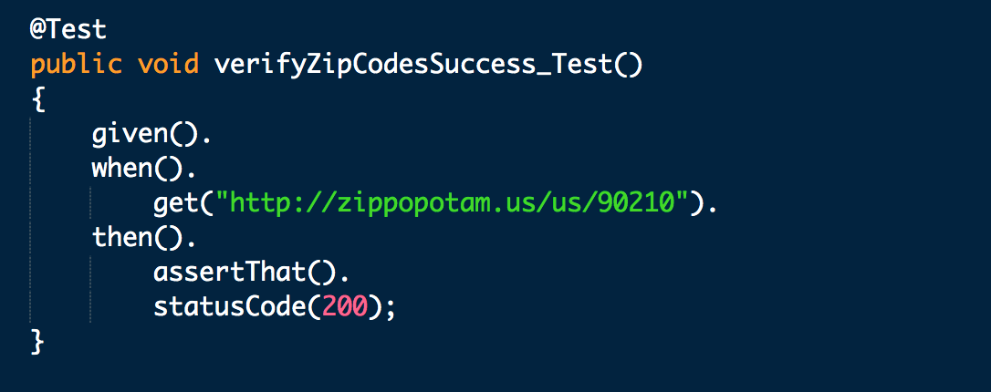
Checking Response Status Code
REST Assured with the status code assertion method, which takes exactly one parameter, being the expected status code, as an integer.

Slide 6
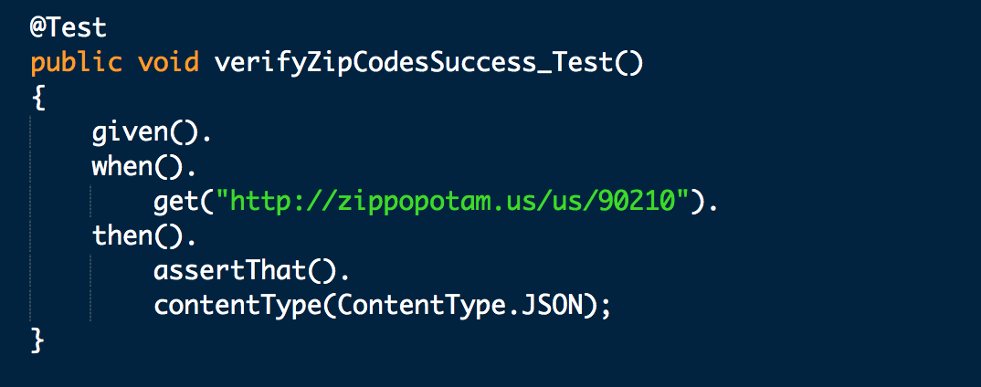
Checking Response Content Type
The content type that's specified in the response header.This content type tells the consumer of the API how to actually decode the response that's being returned by the API provider, so this is a very important header. We can also use contentType("application/json")

Slide 7
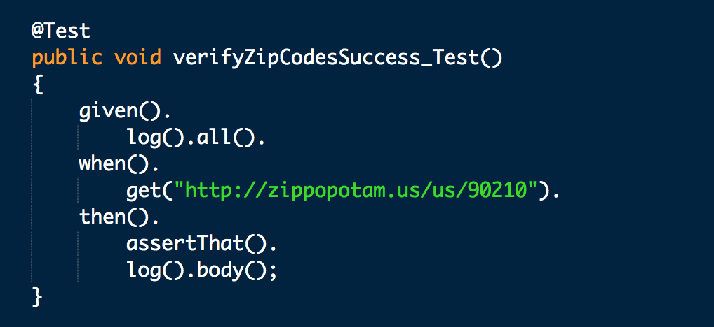
Logging Request and Response
API requests and responses contain much more data than just a status code or a content type.
To see everything that's being returned by the API provider when you put in a request, you can do so with the help of a number of logging statements.

Slide 8
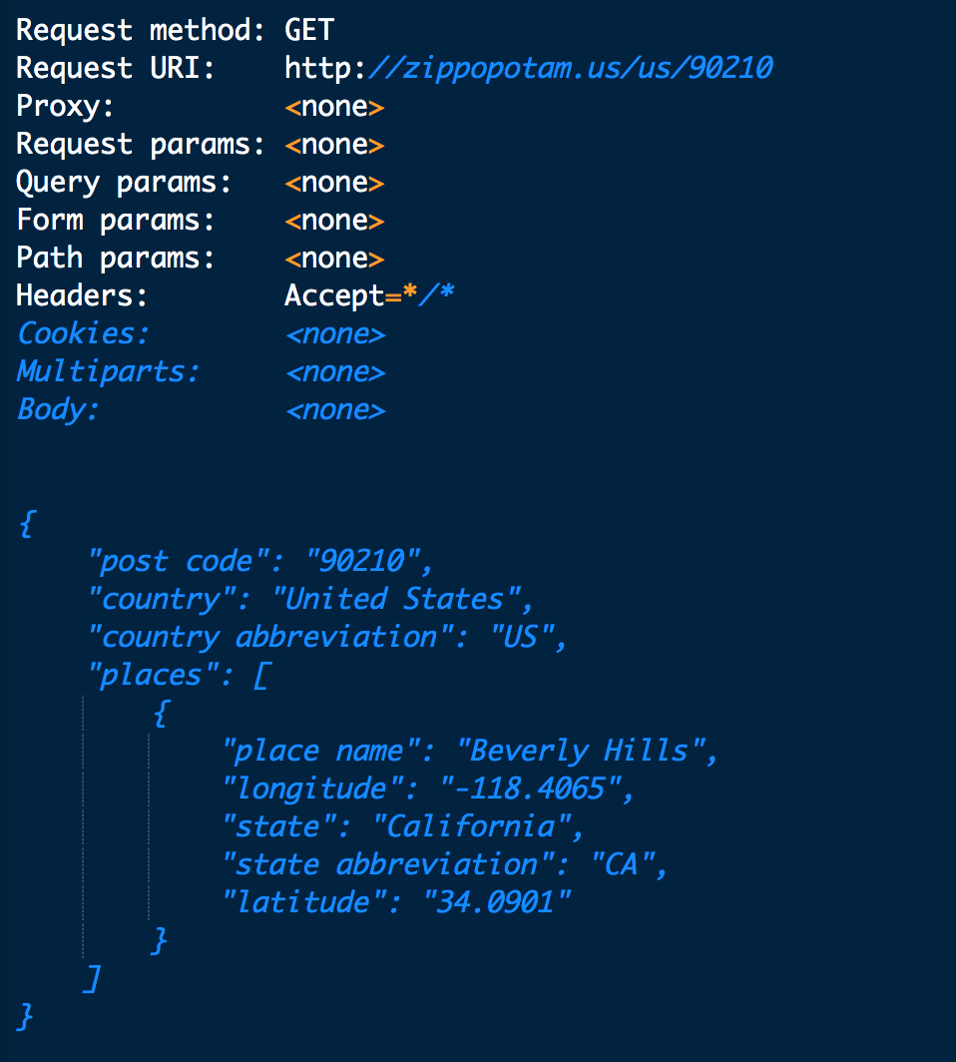
Logging Request and Response Logs
Specified log().all() and this tells REST Assured to write everything there is to know about the API request to the standard output.
Similar after the then method, and this tells REST Assured to log the contents of the response body to the standard output as well.

Slide 9
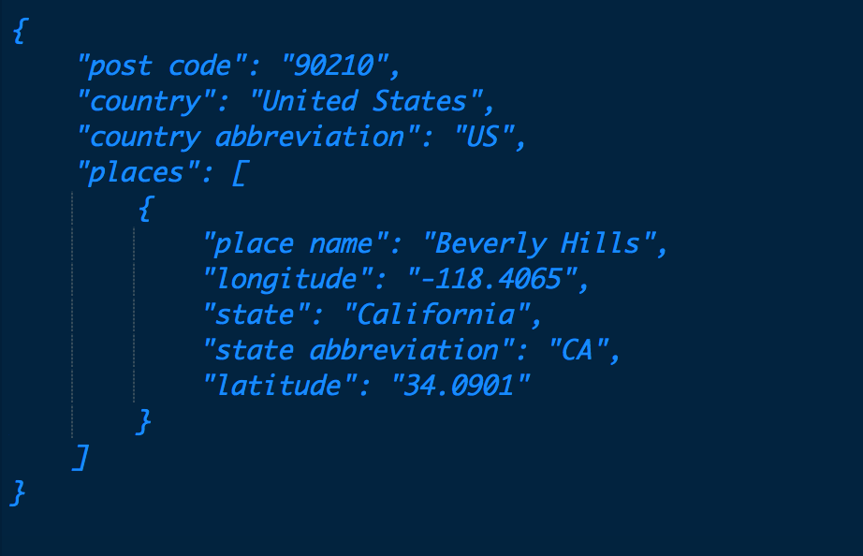
JSONPath usage for verifying Response body
JsonPath is a path expression language of JSON. It's really similar to what XmlPath does for XML and what XPath does for HTML.
e.g Jsonpath for few items
county = country
2. state=places[0].state
3. latitude=places[0].latitude

Slide 10
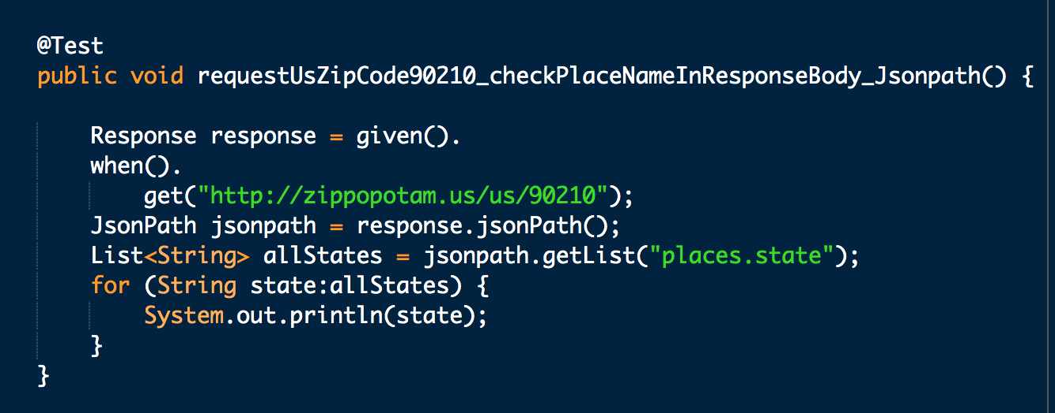
JSONPath usage for verifying Response body

Slide 11
Hamcrest matchers
Hamcrest Matchers allow you to express expectations or checks or verifications you want to perform in your automated tests in readable language.
Some examples,
equalTo(X) - used to check whether an actual element value is equal to a pre-specified expected element value
hasItem("value") - used to see whether a collection of elements contains a specific pre-specified item value
hasSize(3) - used to verify the actual number of elements in a collection
not(equalTo(X)) - inverts any given matcher that exists in the Hamcrest library

Slide 12
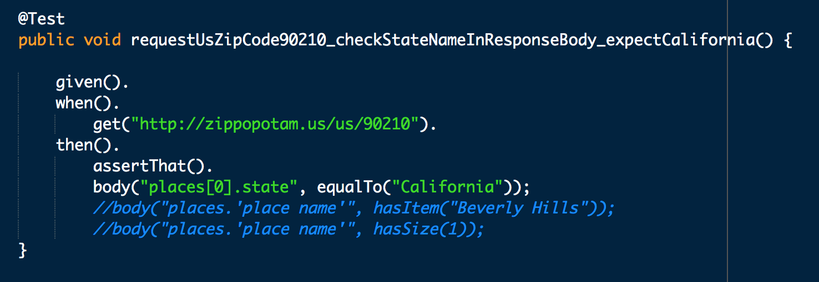
Hamcrest matchers examples

Slide 13
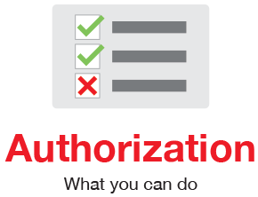

Authentication vs Authorization
Authentication: Authentication proves that you are who you say you are.Refers to providing correct identity.
e.g. Having a driver license which is given by a trusted authority that the requester, such as a police officer, can use as evidence that suggests you are in fact who you say you are.
Authorization: Authorization is when an entity proves a right to access. In other words, Authorization proves you have the right to make a request. Refers to allowing a certain action.
e.g. Consider the following - You have a working key card that allows you to open only some doors in the work area, but not all of them.

Slide 14
Authorization Types
Basic:- With this method, the sender places a username:password into the request header.
Authorization: Basic bG9sOnNlY3VyZQ==
2. Bearer:- The client must send this token in the Authorization header when making
requests to protected resources.
Authorization: Bearer <token>
3. Digest Auth:- Uses the HTTP protocol, applying MD5 cryptographic hashing and a
nonce value to prevent replay attacks
4. OAuth 2.0:- Delegates security to the HTTPS protocol. OAuth2 also introduced
the use of refresh tokens that allow authentications to expire,
unless “refreshed” on a periodic basis

Slide 15
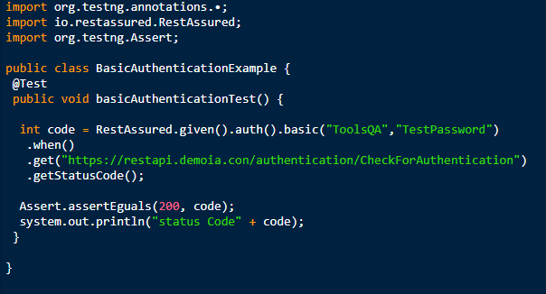
Basic Auth

Slide 16
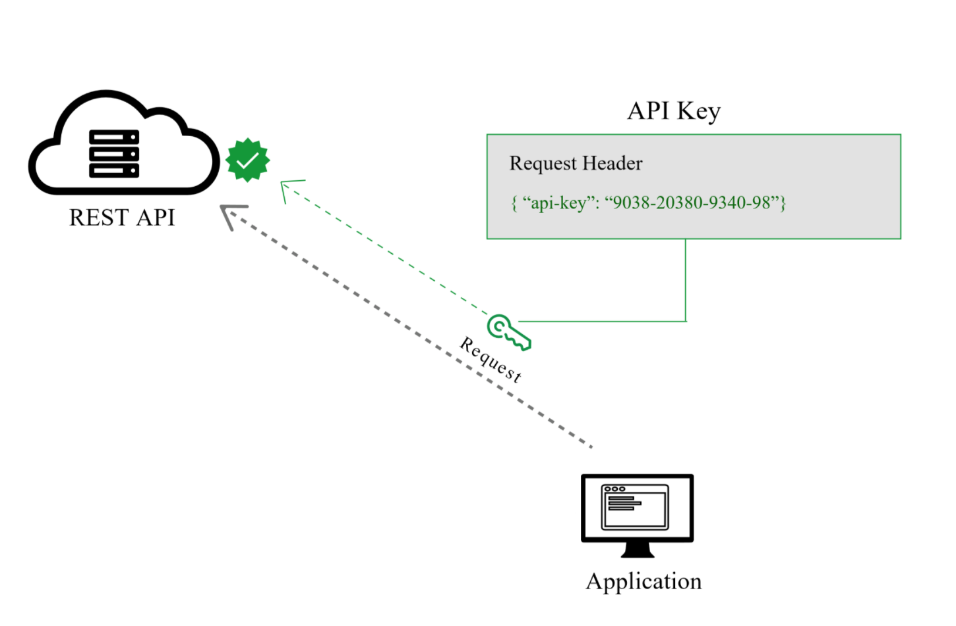
API Keys

Slide 17


